Slide 1


SELF STABILIZING PLATFORM

Slide 2
ABSTRACT
 The project uses PID to obtain filtered values regarding the position of the accelerometer/gyroscope(MPU6050) as feedback which it then uses to remain in the calibrated position despite a displacement. Servo motors have been programmed to obey the microcontroller based on the feedback received from the gyroscope.

Slide 3
MERITS OF THE PROJECT
 The need for stabilizing mechanisms is wide-spread. Various techniques are applied in search of the ideal solution. A common application is camera stabilization, less common are perhaps self-leveling anti-motion sickness seats or surgery platforms.

Slide 4
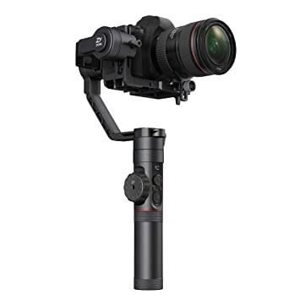
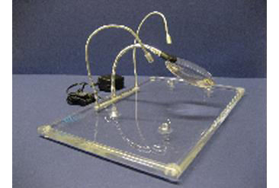
APPLICATIONS
camera and surgery stabilizing platforms

Slide 5
COMPONENTS USED
 The MPU6050 combines a three axis gyroscope and a three axis accelerometer on the same board, along with an onboard digital motion processor(DMP) it can accurately track user motions. With the gyroscope and accelerometer, which both are triple axis Micro Electrical Mechanical systems(MEMS), it can provide information of the boards angular position and acceleration.

Slide 6
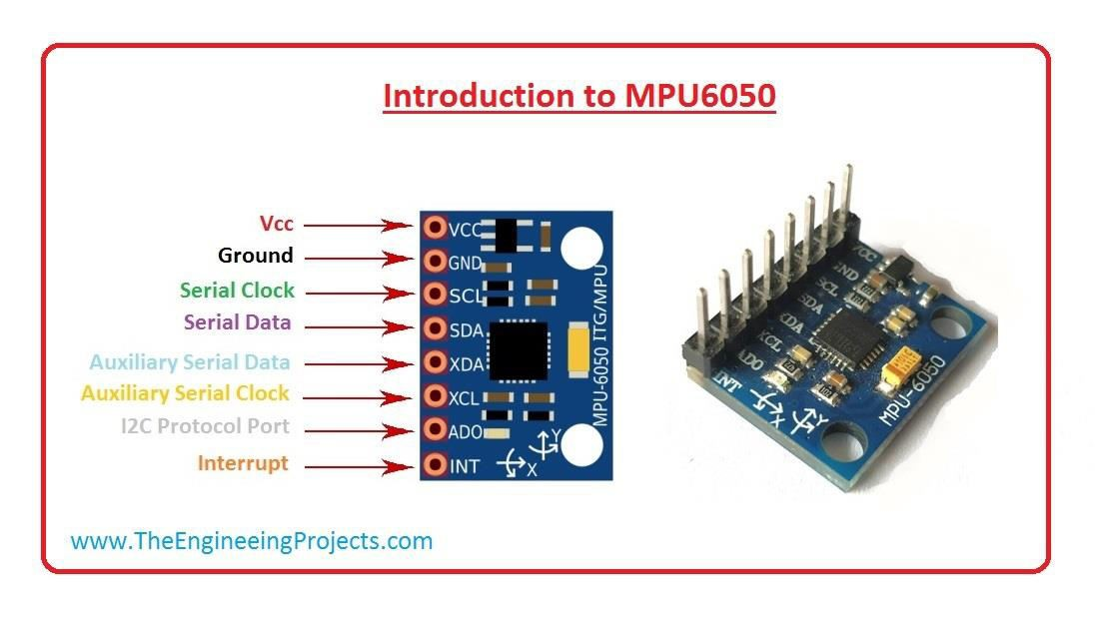

Slide 7
COMPONENTS USED
 MICROCONTROLLER-ARDUINO UNO
 The arduino uno microcontroller is a small device and therefore suitable for small projects. The dimension of the board is 45x17 mm and 10mm thick with the pins attached. It is a breadboard based on the microchip AT mega 328 and equipped with 8 analog pins and 14 digital pins of which six are PWM enabled. The mini USB port is used for programming, but can also be used as a power source. All arduino boards have software included, Arduino IDE. This means the board can be plugged into the computer and be programmed through Arduino’s own software.

Slide 8
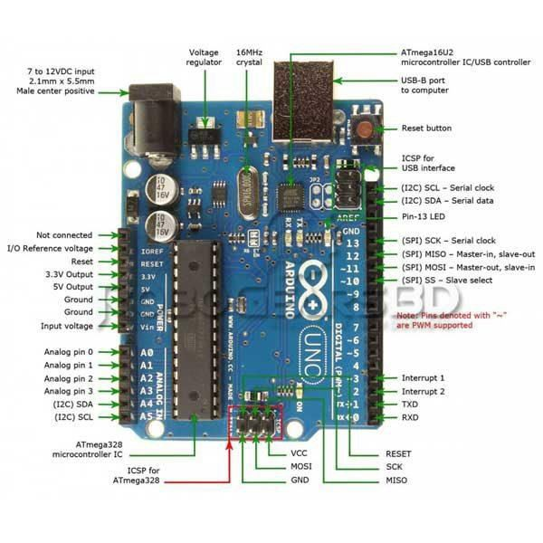

Slide 9
COMPONENTS USED
 SERVO MOTOR-MICRO 9G SERVO FS90
 It is a small yet powerful servo motor with the ability to rotate approximately 180 degrees with a torque output of approx
0.127 Nm. The dimensions of the servo motor is 23.2x12.5x22 mm and weighs 9 grams. The motor have 3 pins in total one for the signals(PWM), one for the input voltage.

Slide 10
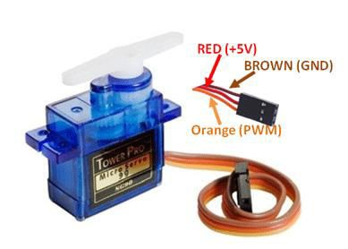

Slide 11
KALMAN FILTER
 Kalman filter is used to optimally estimate the variables of interest when they cant be measured directly. They are also used to find the best estimate of states by combining measurements from various sensors in presence of noise.

Slide 12
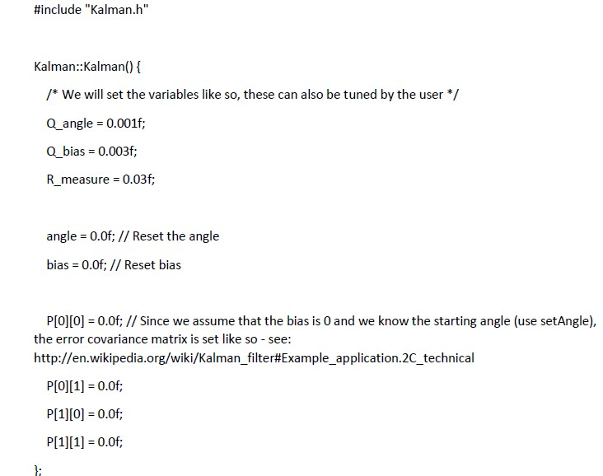
Code for kalman filter

Slide 13
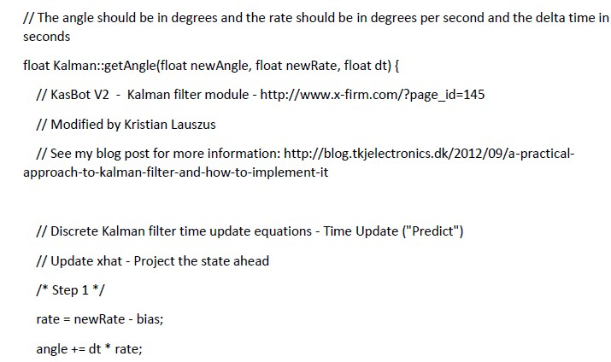

Slide 14
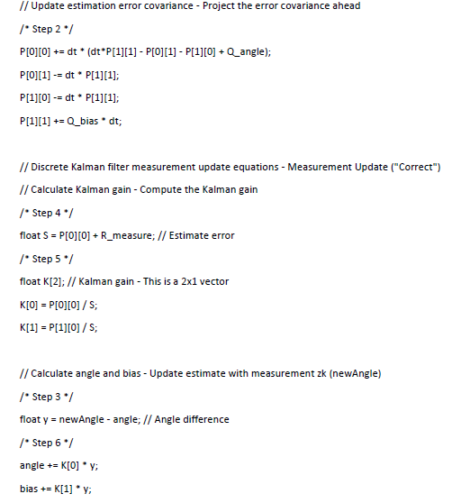

Slide 15
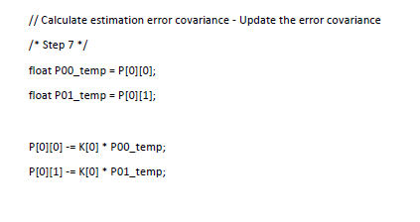
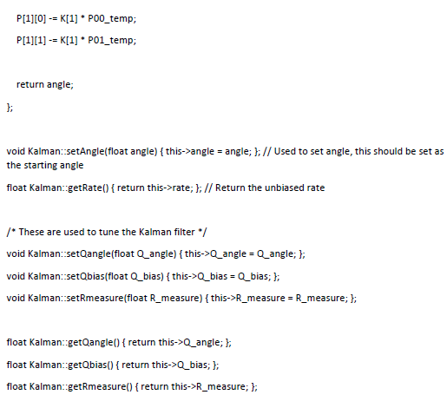

Slide 16
methodology
 We use the Kalman Filter as the statistical model for
this project, so that we can reduce the input error. So that the tilt and accelerating values in the direction are stable and do not vary constantly.
 We use the Arduino Uno microcontroller as a PID controller so that we can reduce the delay from the existing methodologies and then it is also useful to reduce the output error by quite a margin

Slide 17
METHODOLOGY
 We will implement a device which passes the values obtained from the gyroscope through a Kalman Filter which parses the data and normalizes it to give a smoother gradient of variation in the values of the gyroscope. This allows for adjustments to be made based on the feedback in a much smoother and error free method. The gyroscope values are passed through a PID system which processes the feedback and gives output values which allow the servo motors to shift in a way that the reference position is maintained without error and with quick response time.

Slide 18
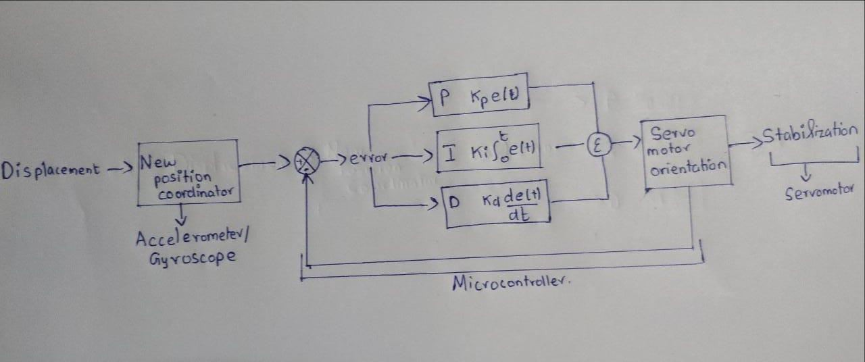
Block diagram

Slide 19
EXPECTED OUTCOME
 The Expected outcome from this project is that we can stabilize a platform using basic components and a smart implementation of statistical models. We got the inspiration for this project after seeing that, there are many people suffering from tremors and this is highly problematic for people as they cannot hold anything stable in their hand. So we will build a self-stabilizing platform which is much cheaper rather than the other high expense ideas which are prevailing all over the country.

Slide 20
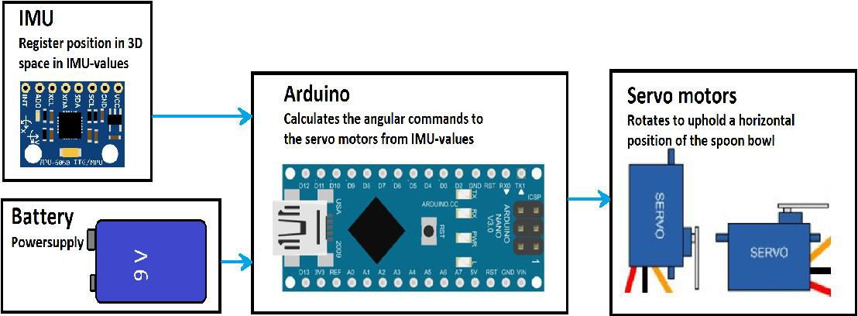
Circuit connections

Slide 21
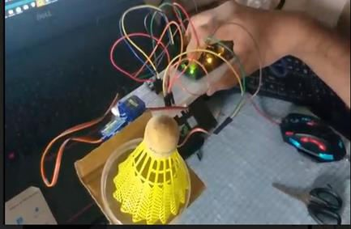
Results obtained

Slide 22
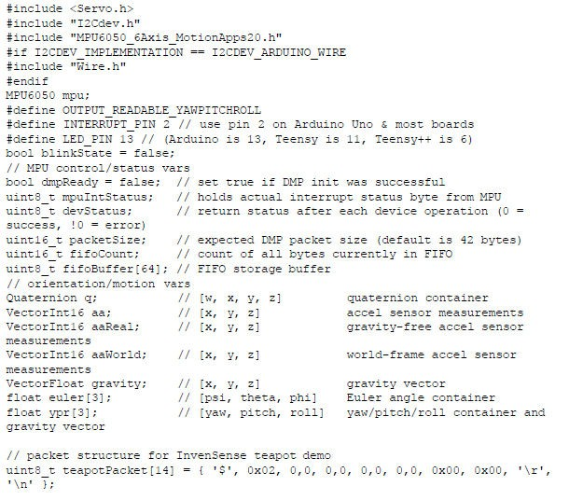

ARDUINO CODE:

Slide 23
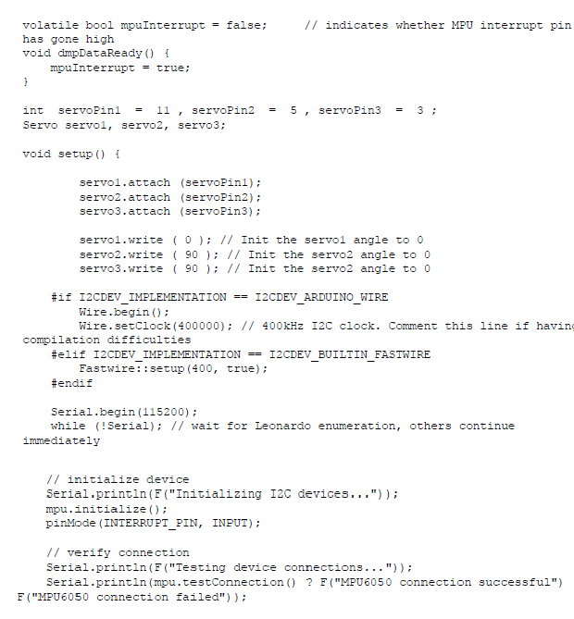

Slide 24
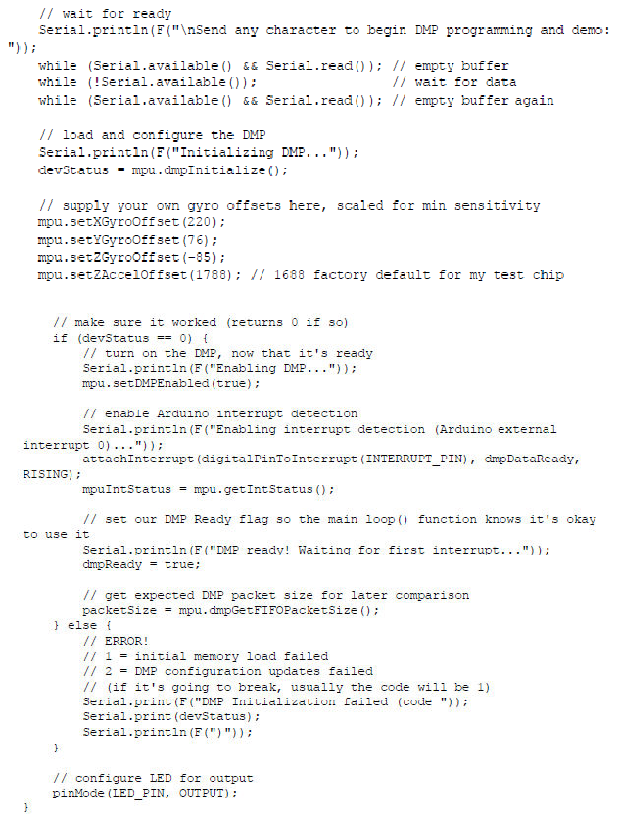

Slide 25
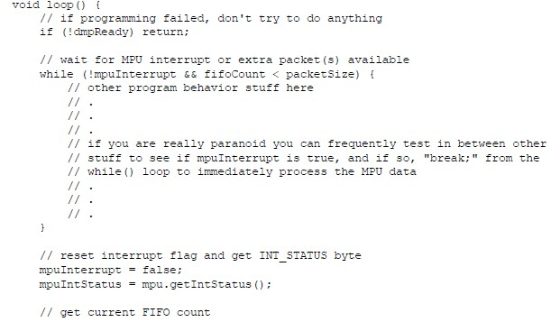
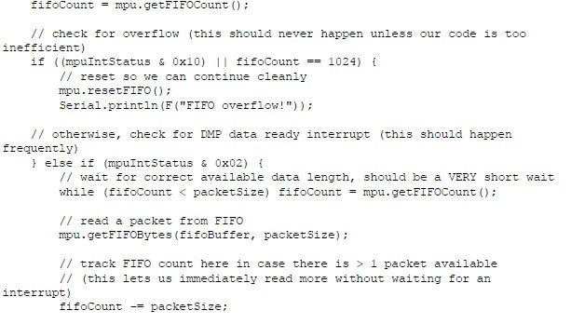

Slide 26
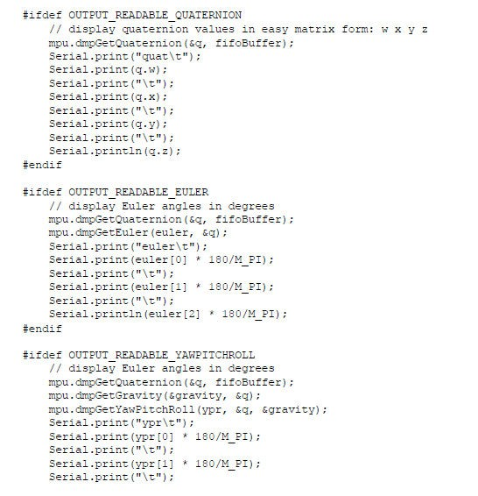

Slide 27
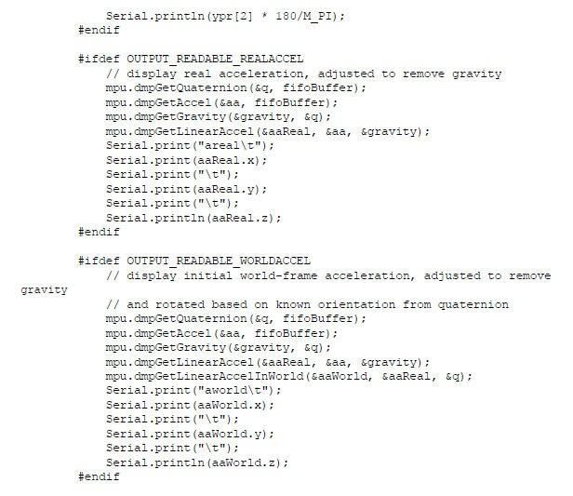

Slide 28
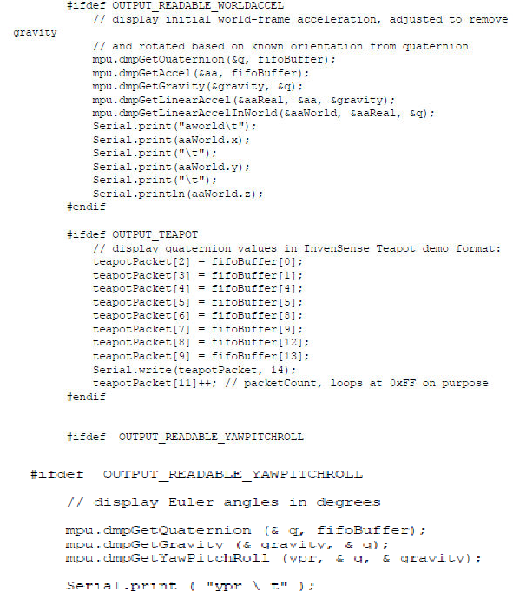

Slide 29
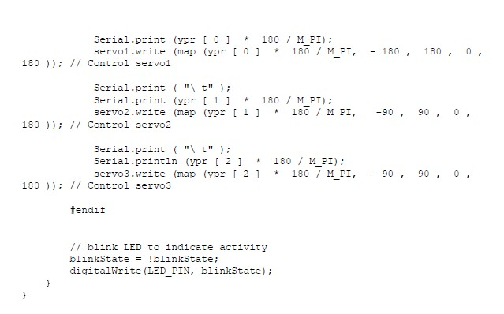

Slide 30
conclusion
 We have concluded from the project that we can stabilize a platform using basic components and a smart implementation using statistical methods
 Link to the video:
 https://drive.google.com/file/d/1ElcZ9-bKk- 0_n3MK0Faamfu4fSEBZTai/view?usp=sharing

